Slide 1
Evidence-Based Practice Models in Healthcare
Overview
Introduction
• Practice (EBP) is a crucial aspect of healthcare decision-making.
• It involves integrating the best available evidence, clinical expertise, and patient preferences within a caring context.
Importance of EBP
Elevates Standard of Care (Engle et al., 2019)
Promotes Patient-Centered Practices
Contributes to a Safe Healthcare Environment
Enhances Efficiency in Healthcare
Facilitates Continuous Improvement
Aligns with Ethical Standards
Responsiveness to Evolving Patient Needs

Slide 2
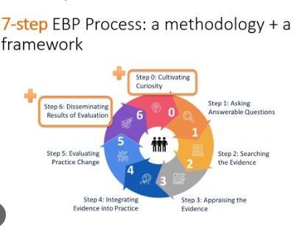
Cont.
Melnyk's 7 Steps
• These steps form the foundation of many EBP initiatives.
• The 7 Steps provide a systematic and structured approach to implementing EBP in healthcare.

Slide 3
Cont.
ARCC Model
• Developed by Bernadette Mazurek Melnyk and colleagues (Melnyk et al., 2016).
• Focuses on improving organizational culture, clinician beliefs, EBP implementation, and patient outcomes.
Notes:
This overview sets the stage for understanding the key components of Melnyk's 7 Steps and the ARCC Model in the context of Evidence-Based Practice in healthcare. The 7 Steps provide a structured approach, while the ARCC Model, as evidenced by the study, demonstrates its effectiveness in enhancing organizational culture, clinician beliefs, EBP implementation, and ultimately, patient outcomes. Let's delve into Melnyk's systematic approach and the collaborative nature of the ARCC Model for a comprehensive understanding of EBP in healthcare.

Slide 4
Comparative Analysis of EBP Models
Key Steps in EBP Models
Melnyk's 7 Steps | ARCC Model steps
0. Cultivate Inquiry | 0 Preparation of EBP mentors
1. Ask Clinical Questions | 1. Organizational culture assessment
2. Find the Evidence | 2. Identifying EBP mentors
3. Appraise the Evidence | 3. Developing EBP mentors
4. Follow the Evidence | 4. Implementing the ARCC Model
5. Implement the Evidence | 5. Evaluating EBP beliefs and outcomes
6. Evaluate & Disseminate | 6. Disseminating outcomes

Slide 5
Cont.
Key Differences and Similarities
Differences
• Melnyk's model does not have a step corresponding to the preparation of EBP mentors.
• The ARCC Model incorporates an organizational culture assessment, a unique feature not present in Melnyk's steps.
• ARCC Model has specific steps dedicated to identifying and developing EBP mentors, as well as implementing the ARCC Model itself.
Similarities
• Both models include steps related to asking clinical questions, finding evidence, appraising evidence, following the evidence, implementing the evidence, and evaluating/disseminating outcomes.
Notes:
This comparative analysis illustrates how Melnyk's foundational steps align and differ with the ARCC Model, showcasing the unique contributions and emphasis of each model in the context of Evidence-Based Practice. While Melnyk's 7 Steps provide a comprehensive framework, the ARCC Model extends the process by incorporating organizational culture assessment and specific strategies for mentor preparation, emphasizing collaboration for improved EBP implementation and patient outcomes. It's important to recognize the distinct strengths and nuances of each model to choose the most suitable approach for implementing Evidence-Based Practice in healthcare settings.

Slide 6
References
Engle, R. L., Mohr, D. C., Holmes, S. K., Seibert, M. N., Afable, M. K., Leyson, J., & Meterko, M. (2019). Evidence-based practice and patient-centered care: Doing both well. Health Care Management Review, 46(3), 174–184. https://doi.org/10.1097/hmr.0000000000000254
Melnyk, B. M., Fineout-Overholt, E., Giggleman, M., & Choy, K. (2016). A test of the ARCC© model improves implementation of Evidence‐Based practice, healthcare culture, and patient outcomes. Worldviews on Evidence-based Nursing, 14(1), 5–9. https://doi.org/10.1111/wvn.12188

