Slide 1
Professional Communication with Colleagues: Using Teach-Back for Improved Understanding
Presented by: Student’s name

Slide 2

Introduction
  Opening statement: Effective communication is the foundation of quality healthcare.
  Teach-Back introduction: The Teach-Back method is a proven strategy for improving patient understanding and reducing medical errors.
  Presentation overview: In this presentation, we'll explore the benefits of Teach-Back, demonstrate its implementation in a real-world scenario, and discuss its role in fostering interprofessional collaboration.
Notes:
Good morning/afternoon/evening, everyone. Effective communication lies at the heart of exceptional patient care. In today's complex healthcare landscape, clear and concise communication between healthcare professionals and patients is more critical than ever. Misunderstandings can lead to serious consequences – wrong medications, missed appointments, or incorrect care procedures.
That's where Teach-Back enters the picture. This innovative technique empowers patients to take ownership of their health by confirming their understanding of crucial information. Over the next few slides, we'll illustrate the power of Teach-Back in action and how it benefits both patients and the healthcare team.

Slide 3
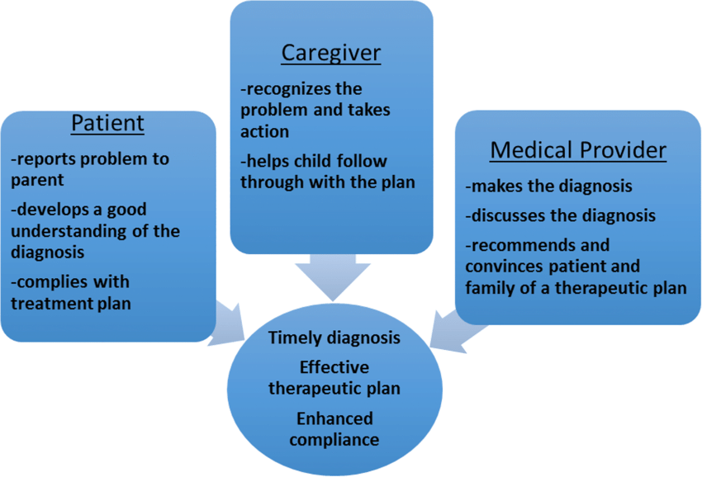
The Teach-Back Method: A Tool for Clear Communication
  Definition: The Teach-Back method is a vital communication technique that actively confirms a patient's or caregiver's understanding of the health information you've provided.
  How it works: Instead of simply asking, "Do you understand?", you encourage the patient to explain the information they heard back to you in their own words.
  Benefits:
    Creates a closed-loop communication system, minimizing misunderstandings.
    Improves patient safety by catching potential errors in how instructions might be interpreted.
    Empowers patients by actively involving them in their own care.
Notes:
Teach-Back is a powerful tool that goes beyond basic patient education. It's NOT about testing someone's intelligence or making them feel uncomfortable. Instead, think of it as a partnership. You're working together with the patient to ensure instructions, medication schedules, treatment plans, and follow-up appointments are crystal clear.
By asking open-ended questions like, "To make sure I explained this clearly, could you please repeat the main points back to me?", you open a dialogue that reveals any gaps in understanding in a respectful and patient-centered manner.

Slide 4
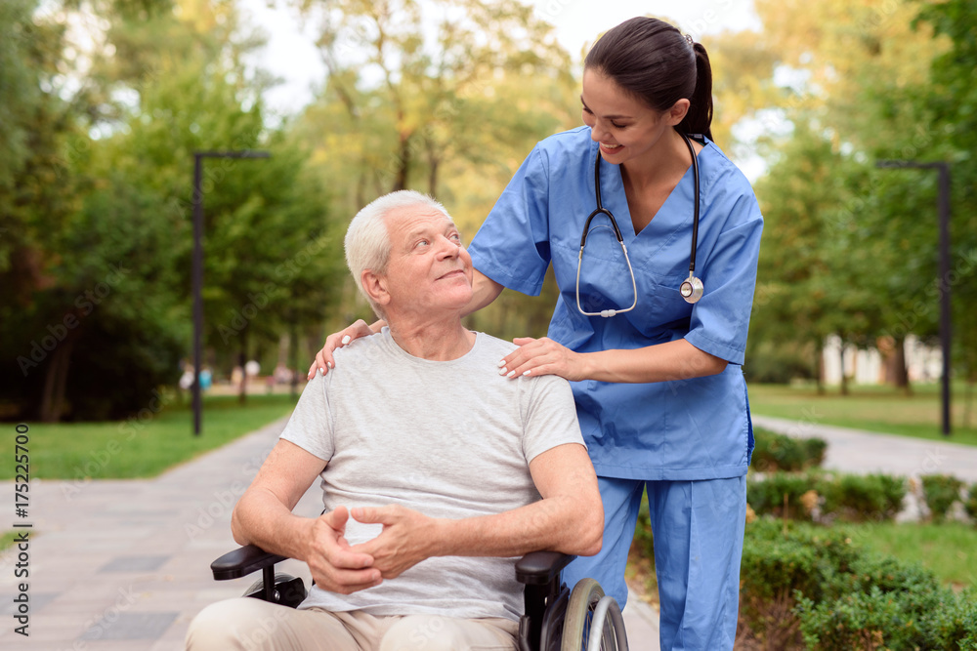
Teach-Back in Action: Supporting Mr. Smith's Post-Surgical Recovery
  Patient: Mr. Smith, a middle-aged man who recently underwent knee replacement surgery.
  Focus: Mr. Smith's transition from hospital to home care.
  Interprofessional Team:
    Nurse: Responsible for wound care, pain management education, and overall instructions.
    Physical Therapist: Provides safe exercise plan and mobility guidance.
    Pharmacist: Reviews medications, dosages, and potential side effects.
Notes:
Mr. Smith is preparing for a major transition – moving from the structured environment of the hospital back to his home. This is a pivotal time where clear, understandable instructions are crucial for his continued recovery and to prevent setbacks.
Our presentation will demonstrate how different members of Mr. Smith's care team utilize the Teach-Back method at each phase of his discharge process. We'll emphasize how Teach-Back fosters a respectful, patient-centered approach that actively engages Mr. Smith in understanding his care plan.

Slide 5
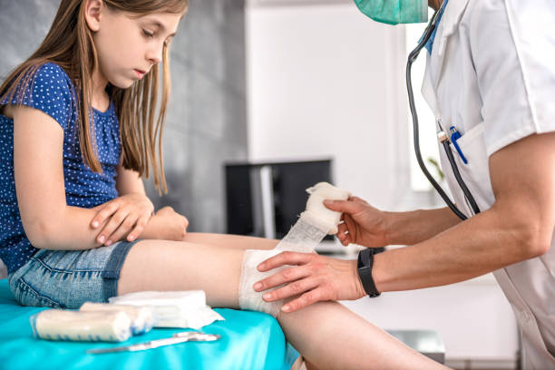
Empowering Mr. Smith Through Wound Care Education
  Plain Language: The nurse avoids complex medical terminology, focusing on everyday words and explanations:
    Instead of "incision," the nurse might say "the cut from your surgery."
    Instead of "sterile," they say "extra clean."
  Step-by-Step Breakdown: The nurse breaks down the wound care process into simple, manageable steps.
  Teach-Back Check: "Mr. Smith, to make sure I was clear, could you please walk me through the steps of cleaning your wound in your own words?"
  Visual Support:
    Provides a clear diagram with numbered steps and pictures.
    Option to show a short, reputable video demonstrating the technique.
Notes:
The nurse plays a vital role in Mr. Smith's post-operative care and his safe transition home. While providing essential wound care instructions, the nurse prioritizes clarity and understanding.
By avoiding medical jargon and using easy-to-follow steps, they create a less intimidating learning environment. The Teach-Back question isn't a quiz but an invitation for Mr. Smith to clarify any confusion and solidify his understanding.
Visual aids like diagrams and videos offer additional reinforcement, catering to different learning styles. The nurse's goal is not just to tell Mr. Smith what to do, but to ensure he feels confident in performing these tasks independently.

Slide 6
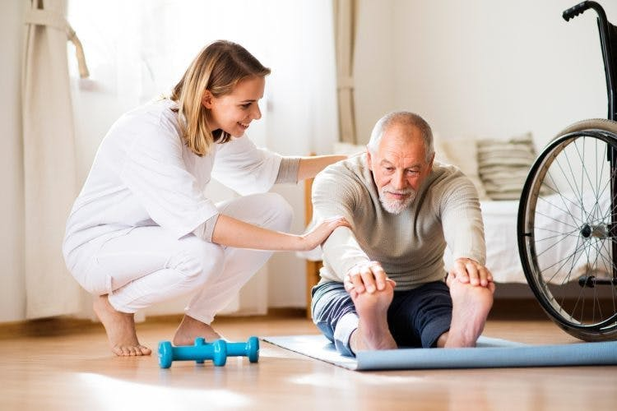
Physical Therapist: Safe At-Home Exercises
  Therapist demonstrates exercises, focusing on proper form.
  Asks Mr. Smith to show the exercises: "Mr. Smith, can you please demonstrate the first exercise I taught you?"
  Offers written instructions and reminders.
Notes:
Physical therapists are key to safe recovery after surgery. Teach-Back allows them to correct any misconceptions in how exercises are performed, preventing injury. It also helps patients gain confidence and feel empowered in their rehabilitation.

Slide 7

Collaboration for Patient Success
  The team discusses Mr. Smith's case, ensuring a seamless care plan.
  Teach-Back findings are shared: "The Teach-Back showed Mr. Smith was unclear about [medication interaction]."
  Solutions are reached: "Perhaps we provide a handout, and the nurse reinforces the information."
Notes:
Teach-Back results help address potential gaps in understanding before discharge. The interprofessional team works in tandem, building on each other's work to optimize Mr. Smith's care journey.

Slide 8

Conclusion
  Teach-Back improves patient understanding and empowerment.
  Improves patient safety and reduces readmission risks.
  Teamwork strengthens patient education through the Teach-Back method.
Notes:
By weaving Teach-Back into professional communication, we enhance patient safety and elevate the quality of care we provide. It's a simple yet powerful tool that encourages active patient engagement, leading to better outcomes.

Slide 9
References
Agency for Healthcare Research and Quality (AHRQ). (2015). Use the teach-back method: Tool 5. Health Literacy Universal Precautions Toolkit (2nd ed., Publication No. 15-0023-EF). https://www.ahrq.gov/health-literacy/improve/precautions/tool5.html
Institute for Healthcare Improvement (IHI). (n.d.). What is teach-back? [Video]. IHI Open School. https://www.ihi.org/education/IHIOpenSchool/resources/Pages/AudioandVideo/ConnieDavis-WhatIsTeachBack.aspx
Koh, H.K., Brach, C., Harris, L.M., & Parchman, M.L. (2013). A proposed 'health literate care model' would constitute a systems approach to improving patients' engagement in care. Health Affairs, 32(2), 357-367. https://doi.org/10.1377/hlthaff.2012.1205
Sharma, R., & Rivet, A. (2023). Teach-back: A patient education technique for enhanced understanding and outcomes. American Journal of Nursing, 123(1), 62-67. https://doi.org/ 10.1097/01.NAJ.0000910268.45126.ae
Ziaeian, B., & Wray, R. (2016). Promoting health literacy and patient empowerment with the teach-back method. The Nurse Practitioner, 41(8), 20-26.

Slide 10
The end

