Slide 1
Chapter 7
Community Health Planning, Implementation, and Evaluation

Slide 2
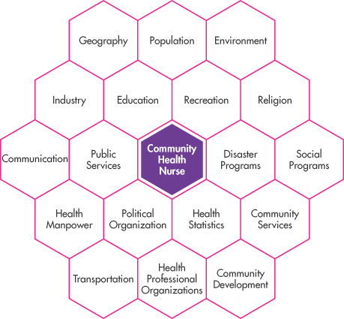
The Community as Client
Figure 7-1

Slide 3
Levels of
Community Health Nursing Practice
Client | Example | Characteristics | Health Assessment | Nursing Involvement
Individual | Lisa McDonald | Individual with various needs | Individual strengths, problems, and needs | Client-nurse interaction
Family | Moniz family | Family system with individual and group needs | Individual and family strengths, problems, and needs | Interactions with individuals and the family group
Group | Boy Scout troop Alzheimer’s support group | Common interests, problems, and needs Interdependency | Group dynamics Fulfillment of goals | Group member and leader
Population group | AIDS patients in a given state Pregnant adolescents in a school district | Large, unorganized group with common interests, problems, and needs | Assessment of common problems, needs, and vital statistics | Application of nursing process to identified needs
Organization | A workplace A school | Organized group in a common location with shared governance and goals | Relationship of goals, structure, communication, patterns of organization to its strengths, problems and needs | Consultant and/or employee application of nursing process to identified needs
Community | Italian neighborhood Anytown, USA | An aggregate of people in a common location with organized social systems | Analysis of systems, strengths, characteristics, problems, and needs | Community leader, participant, and health care provider

Slide 4
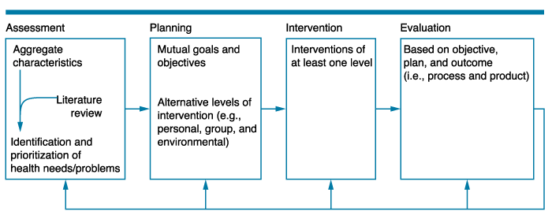
Health Planning Model
Figure 7-2
Hogue (1985)

Slide 5

Steps in the Health Planning Model
Assessment
  Meet with group leaders of aggregate to clarify mutual expectations
  Determine sociodemographic characteristics
  Interview a key informant
  Consider both positive and negative factors
  Compare the aggregate with the “norm”
  Research potential problems
  Identify health problems and needs
  Prioritize the identified problems and needs to create an effective plan

Slide 6
Four Types of Needs to Assess
Expressed needs
  Demand for services and the market behavior of the targeted population
Normative needs
  Lack, deficit, or inadequacy of services determined by health professionals
Perceived needs
  Wants and desires expressed by audience
Relative needs
  Gap showing health disparities between advantaged and disadvantaged population

Slide 7
Factors for Determining Priorities
Aggregates preferences
Number of individuals affected by the health problem
Severity of the health need or problem
Availability of potential solutions
Practical considerations such as skills, time, and available resources
May use Maslow’s hierarchy of needs or levels of prevention to further refine priorities

Slide 8

Community Involvement Is Essential
“Start where the people are!”
Five spheres of empowerment
  Interpersonal (personal empowerment)
  Intragroup (small group development)
  Intergroup (community)
  Interorganizational (coalition building)
  Political action
  – Labonte (1994)

Slide 9
Steps in the Health Planning Model (Cont.)
Planning
  Determine the intervention levels
    Subsystem, aggregate system, and/or suprasystem
  Plan interventions for each system level
    Primary, secondary, or tertiary levels of prevention
  Validate the practicality of the planned interventions according to available resources
    Personal, aggregate, and suprasystem

Slide 10
Development of Goals and Objectives
Goals—where we want to be
Objectives—steps needed to get there
  Measurable
  Specific measures
  Instructions to guide population
  Used to measure outcomes

Slide 11
Steps in the Health Planning Model (Cont.)
Intervention
  Often the most enjoyable stage for the nurse and the clients
  Implementation should follow the initial plan
  Should include a variety of strategies
  Prepare for unexpected problems

Slide 12
Interventions by
Type of Aggregate and System Level
Project | Type of Aggregate | System Level for Intervention
Rehabilitation group | Group | Subsystem and aggregate system
Textile industry | Organization | Aggregate system and suprasystem
Crime watch | Group, organization, and population group | Aggregate system and suprasystem
Bilingual students (case study) | Community | Aggregate system and suprasystem

Slide 13
Steps in the Health Planning Model (Cont.)
Evaluation
  Include the participant’s verbal or written feedback and the nurse’s detailed analysis
  Reflect on each previous stage to determine the plan’s strengths and weaknesses
  Evaluate both formative (process) and summative (product/outcome) aspects
  Communicate follow-up recommendations

Slide 14
Importance of Each Step in the Nursing Process
Aggregate assessments must be thorough.
  Should elicit answers to key questions about the aggregate’s health and demographic profile
  Should compare this information with similar aggregates presented in the literature
The nurse must complete careful planning and set goals that the nurse and the aggregate accept.
  Mutual planning is very important.
Interventions must include aggregate participation and must meet the mutual goals.
Evaluation must include process and product evaluation and aggregate input.

Slide 15
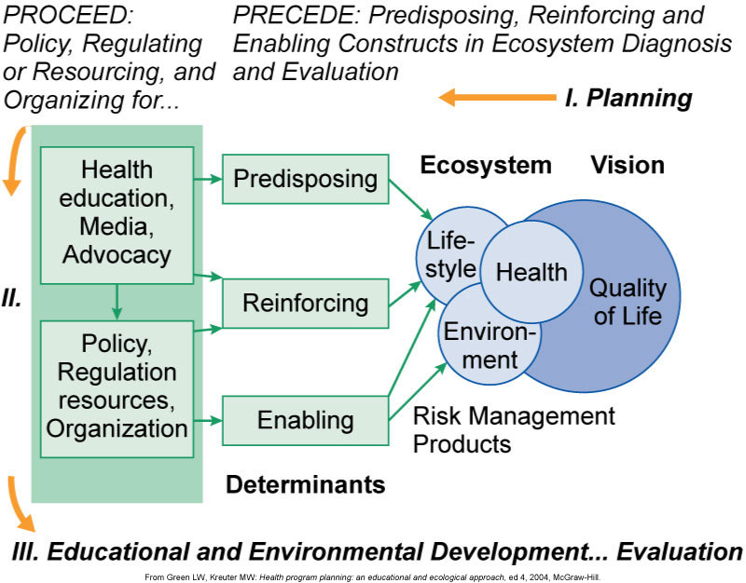
PRECEDE-PROCEED Model

Slide 16

Federal Legislation Affecting Health Planning
Hill-Burton Act
Regional Medical Programs (RMP)
Partnership for Health Program (PHP)
Certificate of Need (CON)
National Health Planning and Resources Development Act

Slide 17
Comprehensive Health Reform
Patient Protection and Affordable Care Act (2010)
  Preventive services based on evidence-based recommendations
  National strategy to improve the nation’s health
  CMMS innovation center
  National quality improvement strategy for services and population health
  Improved access to care
  Reduction in the growth of Medicare spending
  National workforce strategy

Slide 18

Nurses’ Role
Work collaboratively with health planners to improve aggregate health
Fuse technology with knowledge of health care needs and skills
Become directly involved in the planning process
Engage in aggregate-level projects

