Slide 1
Chapter 5
Epidemiology

Slide 2
Epidemiology Is …
… the study of the distribution and determinants of health and disease in human populations
(Harkness, 1995)
… the principal science of public health

Slide 3
Historical Perspective
  Investigations of disease pattern in the community; comparing people who had disease or who remained healthy
Person-Place-Time Model
  Person: “Who” factors, such as demographic characteristics, health, and disease status
  Place: “Where” factors, such as geographic location, climate and environmental conditions, political and social environment
  Time: “When” factors, such as times of day, week, or month and secular trends over months and year

Slide 4
Different Types of Epidemiology
Descriptive Epidemiology
  Study of the amount and distribution of disease
  Used by public health professionals
  Identified patterns frequently indicate possible causes of disease
Analytic Epidemiology
  Examine complex relationships among the many determinants of disease
  Investigation of the causes of disease, or etiology

Slide 5
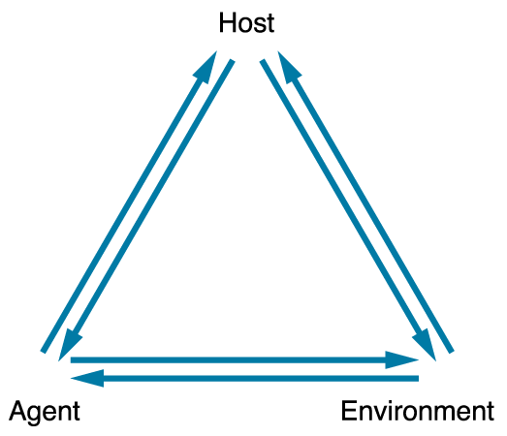
Epidemiological Triangle
Figure 5-1

Slide 6
Agent of Disease
(Etiologic Factors)
Nutritive elements
  Excesses, deficiencies
Chemical agents
  Poisons, allergens
Physical agents
  Ionizing radiation, mechanical
Infectious agents
  Metazoa, protozoa, bacteria, fungi, rickettsia, viruses

Slide 7
Host Factors–Intrinsic Factors
(Susceptibility, or Response to Agent)
Genetic
Age
Sex
Ethnic group
Physiological state
Prior immunological experience
  Active/, passive
Intercurrent or preexisting disease
Human behavior

Slide 8
Environmental Factors— Extrinsic Factors…
… influence existence of the agent, exposure, or susceptibility to agent
Physical environment
Biological environment
  Human populations, flora, fauna
Socioeconomic environment
  Occupation, urbanization and economic development, disruption

Slide 9
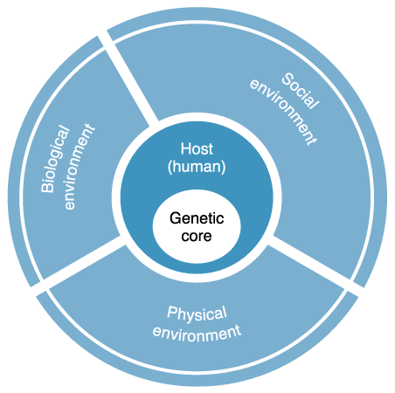
Wheel Model of
Human-Environment Interaction
Figure 5-2
Redrawn from Mausner JS, Kramer S: Mausner and Bahn epidemiology: an introductory text, ed 2, Philadelphia, 1985, Saunders.

Slide 10
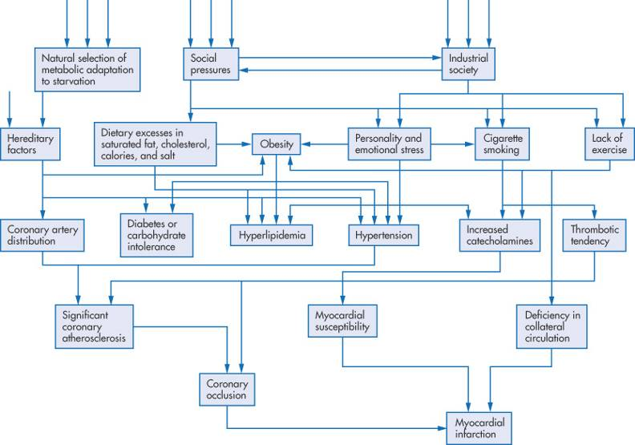
Web of Causation
Figure 5-3
From Friedman GD: Primer of epidemiology, ed 4, New York, 1994, McGraw-Hill.

Slide 11
Ecosocial Approach
Emphasize the role of evolving macro-level socioenvironmental factors along with microbiological process in understanding health and illness (Smith & Lincoln, 2011)
Challenges the more individually focused risk factor approach to understanding disease origins

Slide 12
Calculation of Rates
Rates are arithmetic expressions that help practitioners consider a count of an event relative to the size of the population from which it is extracted
  Number of health events in a specified period
  Population in same area in same specified period
    Proportion multiplied by a constant (k)
    For example, the rate can be the number of cases of a disease occurring for every 1000, 10,000 or 100,000 people in the population
  Can make meaningful comparisons

Slide 13
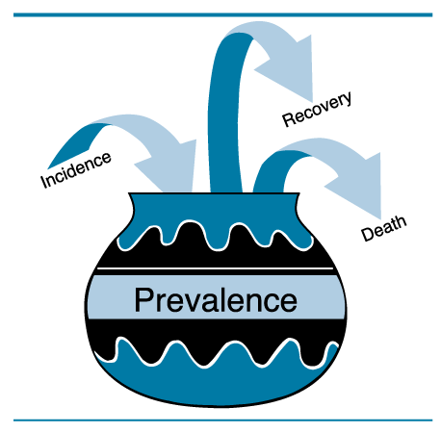
Morbidity Rates
Incidence rates
  New cases or conditions
  Attack rate
    Number of new cases of those
    exposed to the disease
Prevalence rates
  All cases of a specific
  disease or condition at
  a given time
Figure 5-4
Redrawn from Morton RF, Hebel JR, McCarter RJ: A study guide to epidemiology and biostatistics, ed 3, Gaithersburg, MD, 1990, Aspen Publishers.
Prevalence Pot
The relationship between incidence
and prevalence

Slide 14

Morbidity Rates (Cont.)
Incidence Rate
Number of new cases
_in given time period
Population at risk in
same time period
___75___
4000–250
× 1000
= 0.02
0.02 × 1,000 = 20 per 1000 per time period
Prevalence Rate
Number of existing cases
Total Population
_____
250
4000
= 0.0625
0.0625 × 1000 = 62.5 per 1000

Slide 15
Mortality Rates
(routinely collected birth and death rates)
Other rates
Crude rates
Age-specific rates
Age-adjusted rates or standardization of rates
Proportionate mortality ratio (PMR)

Slide 16
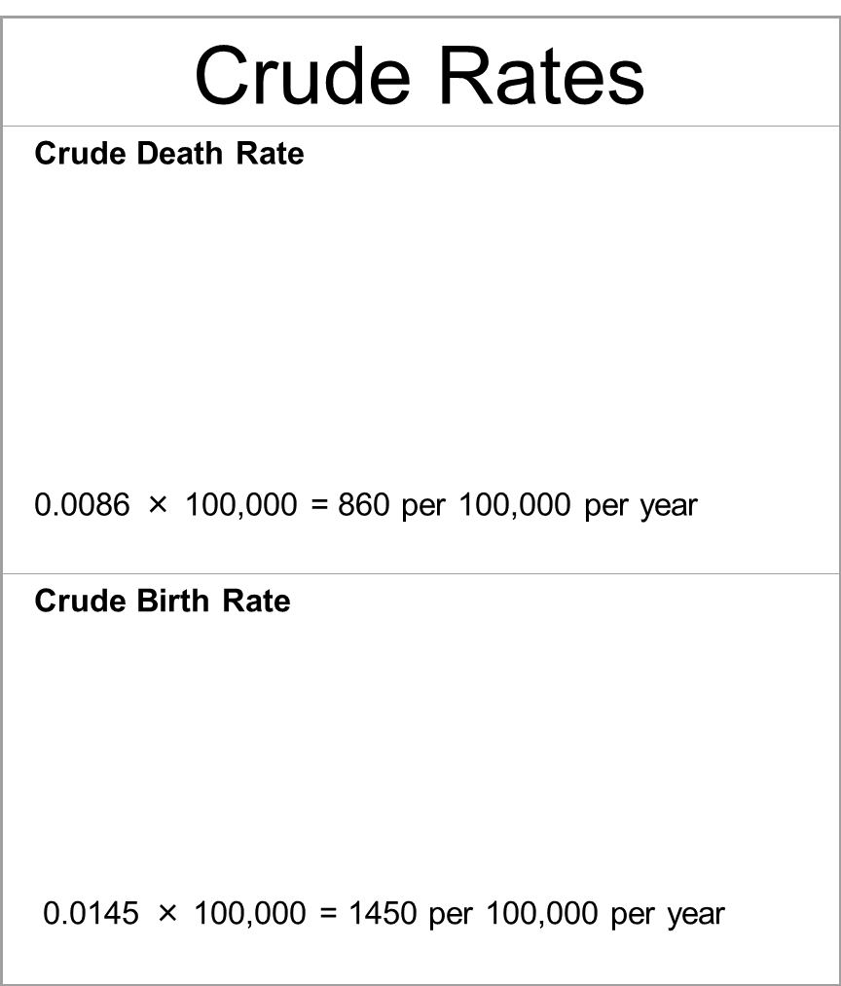
Number of deaths in year
Total population size
_1720_
200,000
× 100,000
= 0.0086
Number of births in year
Total population size
_2900_
200,000
× 100,000
= 0.0145

Slide 17
Concept of Risk
Risk—probability of an adverse event
Risk factor
  Refers to the specific exposure factor
  Often external to the individual
Attributable risk
  Estimate of the disease burden in a population
Relative risk ratio
  Divide the incidence rate of disease in the exposed population by the incidence rate of disease in the nonexposed population.

Slide 18
Use of Epidemiology
Disease prevention
  Primary prevention
    Health promotion and specific prevention
  Secondary and tertiary prevention
  Establishing causality
  Screening
  Surveillance

Slide 19
Use of Epidemiology (Cont.)
Health services
  Used to describe the distribution of disease and its determinants in populations
  Study population health care delivery
  Evaluate use of community health services
Nurses must apply findings in practice
  Incorporate results into prevention programs for communities and at-risk populations
  Extend application into major health policy decisions

Slide 20
Community health nurses should exercise “social responsibility” in applying epidemiological findings, but this will require the active involvement of the consumer.
Community health nurses collaborating with community members can combine epidemiological knowledge and aggregate-level strategies to affect change on the broadest scale.

Slide 21
Epidemiological Methods
Descriptive epidemiology
  Focuses on the amount and distribution of health and health problems within a population
Analytic epidemiology
  Investigates the causes of disease by determining why a disease rate is lower in one population group than in another

Slide 22
Analytic Epidemiology
Observational studies
  Descriptive purposes
  Etiology of disease
  No manipulation by investigator
Cross-sectional studies
  Sometimes called prevalence or correlational studies
  Examine relationships between potential causal factors and disease at a specific time
  Impossible to make causal inferences

Slide 23
Analytic Epidemiology (Cont.)
Retrospective studies
  Compare individuals with a particular condition or disease with those who do not have the disease
  Data collection extends back in time
Prospective studies
  Monitor a group of disease-free individuals to determine if and when disease occurs
  Cohort shares a common experience within a defined time period
  Monitors cohort for disease development

Slide 24
Analytic Epidemiology (Cont.)
Experimental design
  Also called a Randomized Clinical Trial (RCT)
    Subjects assigned to experimental or control group
    Apply experimental methods to test treatment and prevention strategies
    Ethical considerations with human subject rights review
  Also useful for investigating chronic disease prevention

